Slide 1
HNDIT 2312-Principles of Software Engineering
Week 3: Agile Software Development

Slide 2
Topics covered
Rapid Application Development
Agile Method
Extreme programming
Large System Development

Slide 3
Rapid software development
Rapid development and delivery is now often the most important requirement for software systems
Businesses operate in a fast –changing requirement and it is practically impossible to produce a set of stable software requirements
Software has to evolve quickly to reflect changing business needs

Slide 4
Rapid software development
Specification, design and implementation are inter-leaved
System is developed as a series of versions with stakeholders involved in version evaluation
User interfaces are often developed using an IDE and graphical toolset.

Slide 5
Why Agile methods?
Dissatisfaction with the overheads involved in software design methods of the 1980s and 1990s led to the creation of agile methods. These methods:
Focus on the code rather than the design
Are based on an iterative approach to software development
Are intended to deliver working software quickly and evolve this quickly to meet changing requirements.

Slide 6
Why Agile methods?
Agile methods are probably best suited to small/medium sized business systems or PC products .

Slide 7
Plan-driven and agile development
Plan-driven development
A plan-driven approach to software engineering is based around separate development stages with the outputs to be produced at each of these stages planned in advance.
Agile development
Specification, design, implementation and testing are inter-leaved and the outputs from the development process are decided through a process of negotiation during the software development process.

Slide 8
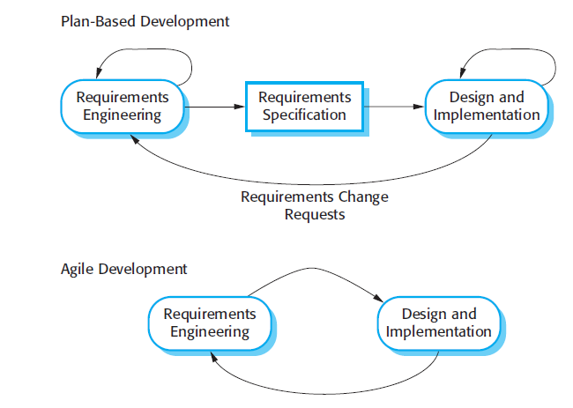
Plan-driven and agile development

Slide 9
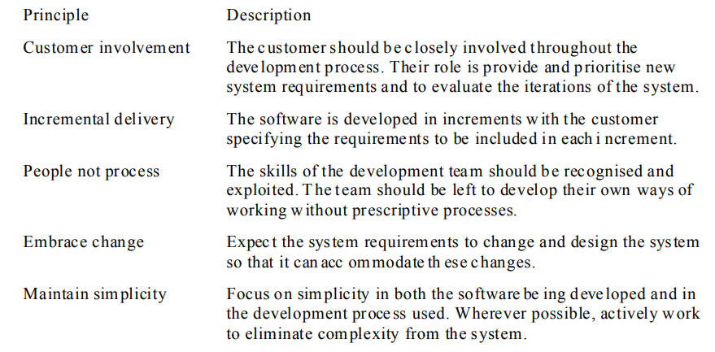
Principles of agile methods Principles of agile methods

Slide 10
Extreme programming
Perhaps the best-known and most widely used agile method.
Extreme Programming (XP) takes an ‘extreme’ approach to iterative development.
New versions may be built several times per day;
Increments are delivered to customers every 2 weeks;
All tests must be run for every build and the build is only accepted if tests run successfully.

Slide 11
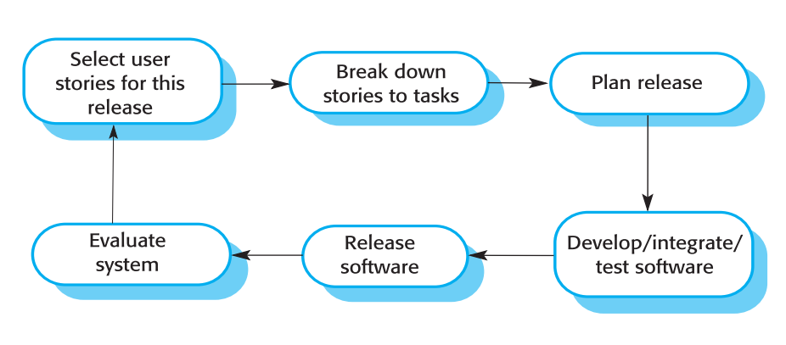
The extreme programming release cycle

Slide 12
Extreme programming practices (a)
Principle or practice | Description
Incremental planning | Requirements are recorded on story cards and the stories to be included in a release are determined by the time available and their relative priority. The developers break these stories into development ‘Tasks’. See Figures 3.5 and 3.6.
Small releases | The minimal useful set of functionality that provides business value is developed first. Releases of the system are frequent and incrementally add functionality to the first release.
Simple design | Enough design is carried out to meet the current requirements and no more.
Test-first development | An automated unit test framework is used to write tests for a new piece of functionality before that functionality itself is implemented.
Refactoring | All developers are expected to refactor the code continuously as soon as possible code improvements are found. This keeps the code simple and maintainable.

Slide 13
Extreme programming practices (b)
Pair programming | Developers work in pairs, checking each other’s work and providing the support to always do a good job.
Collective ownership | The pairs of developers work on all areas of the system, so that no islands of expertise develop and all the developers take responsibility for all of the code. Anyone can change anything.
Continuous integration | As soon as the work on a task is complete, it is integrated into the whole system. After any such integration, all the unit tests in the system must pass.
Sustainable pace | Large amounts of overtime are not considered acceptable as the net effect is often to reduce code quality and medium term productivity
On-site customer | A representative of the end-user of the system (the customer) should be available full time for the use of the XP team. In an extreme programming process, the customer is a member of the development team and is responsible for bringing system requirements to the team for implementation.

Slide 14
Requirements scenarios
In XP, a customer or user is part of the XP team and is responsible for making decisions on requirements.
User requirements are expressed as scenarios or user stories.
These are written on cards and the development team break them down into implementation tasks. These tasks are the basis of schedule and cost estimates.
The customer chooses the stories for inclusion in the next release based on their priorities and the schedule estimates.

Slide 15
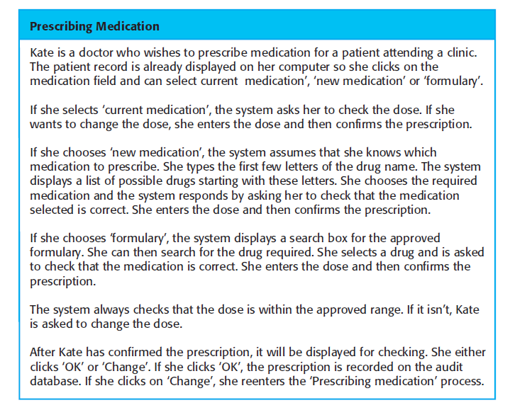
A ‘prescribing medication’ story

Slide 16
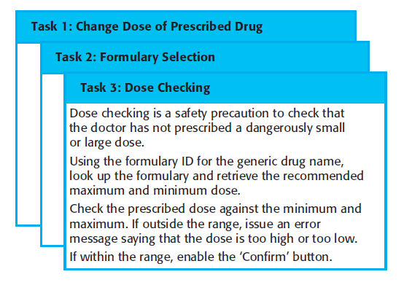
Examples of task cards for prescribing medication

Slide 17
Refactoring in XP
Programming team look for possible software improvements and make these improvements even where there is no immediate need for them.
This improves the understandability of the software and so reduces the need for documentation.
Changes are easier to make because the code is well-structured and clear.
However, some changes requires architecture refactoring and this is much more expensive.

Slide 18
Examples of refactoring
Re-organization of a class hierarchy to remove duplicate code.
Tidying up and renaming attributes and methods to make them easier to understand.
The replacement of inline code with calls to methods that have been included in a program library.

Slide 19
Testing in XP
Testing is central to XP and XP has developed an approach where the program is tested after every change has been made.
XP testing features:
Test-first development.
Incremental test development from scenarios.
User involvement in test development and validation.
Automated test harnesses are used to run all component tests each time that a new release is built.

Slide 20
Test-first development
Writing tests before code clarifies the requirements to be implemented.
Tests are written as programs rather than data so that they can be executed automatically. The test includes a check that it has executed correctly.

Slide 21
Pair programming
In XP, programmers work in pairs, sitting together to develop code.
This helps develop common ownership of code and spreads knowledge across the team.
It serves as an informal review process as each line of code is looked at by more than 1 person.
It encourages refactoring as the whole team can benefit from this.

Slide 22
RAD environment tools
Database programming language
Interface generator
Links to office applications
Report generators

Slide 23
Problems with agile methods
It can be difficult to keep the interest of customers who are involved in the process.
Team members may be unsuited to the intense involvement that characterizes agile methods.
Prioritizing changes can be difficult where there are multiple stakeholders.
Maintaining simplicity requires extra work.
Contracts may be a problem as with other approaches to iterative development.

Slide 24
Large system development
Large systems and their development processes are often constrained by external rules and regulations limiting the way that they can be developed.
Large systems have a long procurement and development time. It is difficult to maintain coherent teams who know about the system over that period as, inevitably, people move on to other jobs and projects.
Large systems usually have a diverse set of stakeholders. It is practically impossible to involve all of these different stakeholders in the development process

Slide 25
Scaling up to large systems
For large systems development, it is not possible to focus only on the code of the system. You need to do more up-front design and system documentation
Cross-team communication mechanisms have to be designed and used.
Continuous integration, where the whole system is built every time any developer checks in a change, is practically impossible. However, it is essential to maintain frequent system builds and regular releases of the system.

Slide 26
Key points
Agile methods are incremental development methods that focus on rapid development, frequent releases of the software, reducing process overheads and producing high-quality code. They involve the customer directly in the development process.
The decision on whether to use an agile or a plan-driven approach to development should depend on the type of software being developed, the capabilities of the development team and the culture of the company developing the system.
Extreme programming is a well-known agile method that integrates a range of good programming practices such as frequent releases of the software, continuous software improvement and customer participation in the development team.

